Slide 1

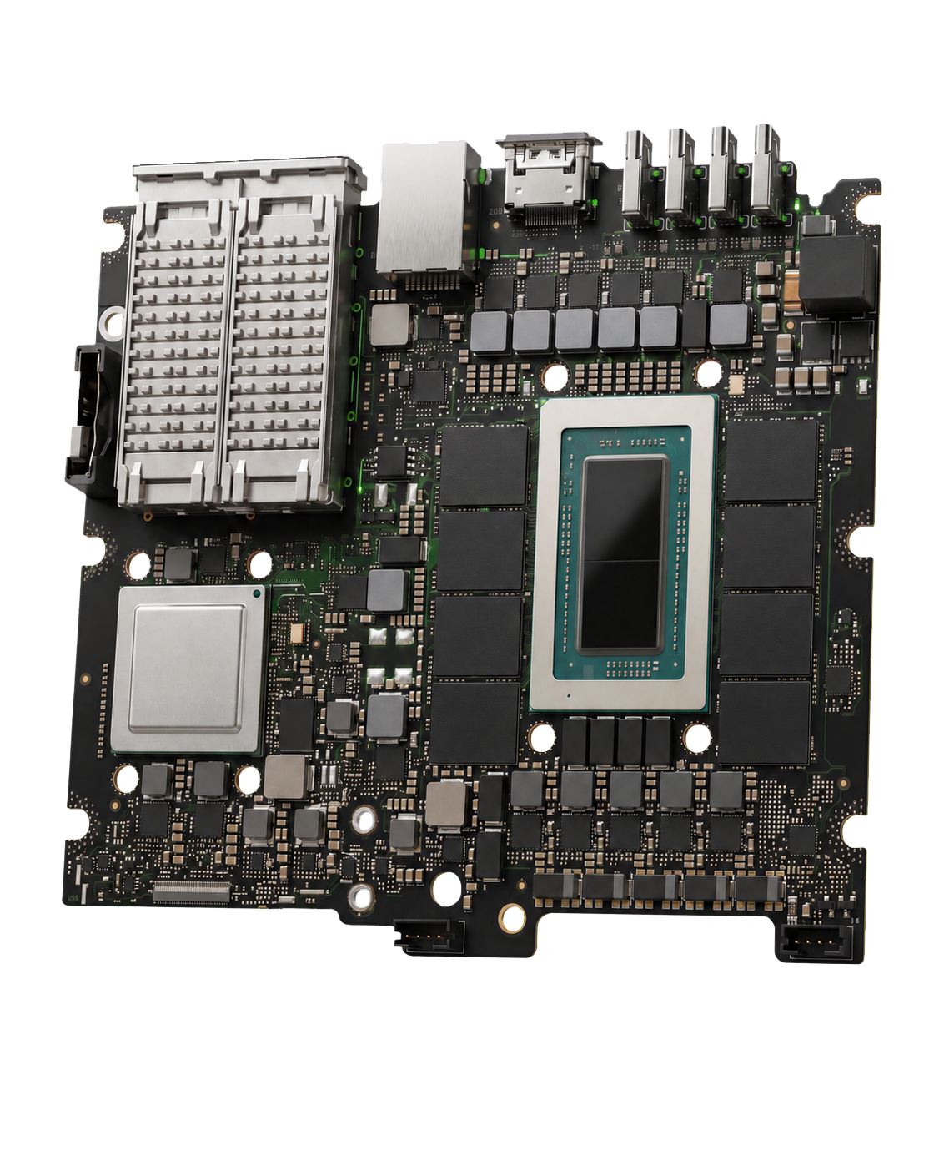
SPLAY
CORPORATE BRIEFING / 2026.09
AI ON
YOUR OWN
HARDWARE
Private AI systems installed on your network. Customers own the hardware. Available for pre-order.
CORPORATE BRIEFING
SPLAY LLC / STAFFORD, VIRGINIA
PRIVATE ON-PREMISES AI
SPLAY.LLC
Notes:
SPLAY provides private on-premises AI systems that customers own. Systems are available for pre-order and include installation.
[Sources]
- https://splay.llc
- https://splay.llc/splay-overview.pdf
- https://splay.llc/paper/node-hero-2160.png
- https://splay.llc/splay-mark-512.png
- https://splay.llc/media/splay/splay-home-hero-core-still-v02-cutout-clean.png
[/Sources]

Slide 2
SPLAY / CORPORATE BRIEFING
PRIVATE AI / PRE-ORDER 02 / 11
AI SYSTEM EVALUATION
Data handling, operating costs, and continuity depend on the system and service terms.
01
DATA HANDLING
Identify who receives files and model traffic. Review access and retention terms.
02
COST MODEL
Compare hardware costs with subscription and usage charges. Include integration and administration.
03
CONTINUITY
Review account dependencies and service terms, including how staff recover or move their work.
EVALUATION REQUIREMENTS DEPEND ON THE ORGANIZATION AND WORKLOAD
SPLAY LLC / STAFFORD, VIRGINIA
SPLAY.LLC
Notes:
Evaluation should address data handling, cost, and service dependencies. Provider terms differ, including retention, access, pricing, and continuity provisions.
[Sources]
- https://splay.llc
- https://splay.llc/company
- https://splay.llc/splay-overview.pdf
[/Sources]

Slide 3
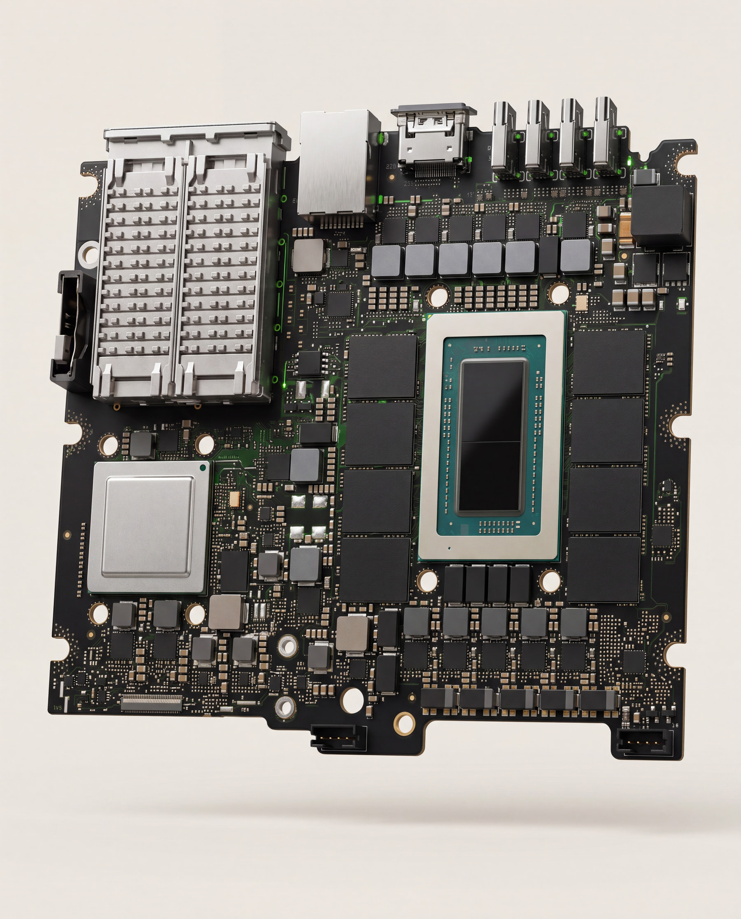
SPLAY / CORPORATE BRIEFING
PRIVATE AI / PRE-ORDER 03 / 11
THE INSTALLED SPLAY SYSTEM
SPLAY supplies the hardware, SplayOS, a tested model, installation, documentation, and support.
HARDWARE
New commercial hardware sized for the workload.
SPLAYOS
The installed workspace for staff, models, document search, permissions, and recovery.
VALIDATED MODEL
SPLAY installs and tests the model before delivery.
INSTALLATION
Network setup, IT documentation, and 90 days of Launch Care.
GB10 CORE / SHOWN
SPLAYOS BROWSER ACCESS AT SPLAY.LOCAL
SPLAY LLC / STAFFORD, VIRGINIA
SPLAY.LLC
Notes:
SPLAY supplies new commercial hardware with SplayOS, a validated model, staff authentication, and outbound model traffic controls. Installation includes documentation and 90 days of Launch Care.
[Sources]
- https://splay.llc
- https://splay.llc/company
- https://splay.llc/capabilities
- https://splay.llc/splay-overview.pdf
- https://splay.llc/media/splay/splay-home-hero-core-still-v02.jpg
[/Sources]

Slide 4
SPLAY / CORPORATE BRIEFING
PRIVATE AI / PRE-ORDER 04 / 11
STAFF ACCESS AND INITIAL USE
SPLAY configures the machine before delivery.
01
02
03
NETWORK CONNECTION
LOCAL INTERFACE
AUTHORIZED FILES
SPLAY connects the Node to your network.
Staff open splay.local in a web browser.
Staff select the source files for each task.
PREPARATION BEFORE DELIVERY
MODEL AND SPLAYOS INSTALLED STAFF ACCESS CONFIGURED OUTBOUND TRAFFIC BLOCKED RESTORE TESTED
SPLAY LLC / STAFFORD, VIRGINIA
SPLAY.LLC
Notes:
SPLAY prepares the system before delivery. Staff access it at splay.local in a browser and select the files authorized for each task.
[Sources]
- https://splay.llc#appliance
- https://splay.llc
[/Sources]

Slide 5
SPLAY / CORPORATE BRIEFING
PRIVATE AI / PRE-ORDER 05 / 11
DOCUMENTS AND INTERNAL TOOLS
A Node drafts work from authorized source files.
SOURCE FILES
OUTPUTS FOR REVIEW
CONTRACTS
PDFS AND SCANS
NOTES AND RECORDINGS
SPREADSHEETS
INTERNAL ARCHIVES
DRAFTS
SUMMARIES
COMPARISONS
RECORD SEARCH
SMALL INTERNAL TOOLS
SPLAY NODE
LOCAL PROCESSING
Staff review and approve the output before using it.
SPLAY LLC / STAFFORD, VIRGINIA
SPLAY.LLC
Notes:
The Node supports document drafting, file search, analysis, and small internal software. Staff review and approve its output before use.
[Sources]
- https://splay.llc
- https://splay.llc/splay-overview.pdf
[/Sources]

Slide 6
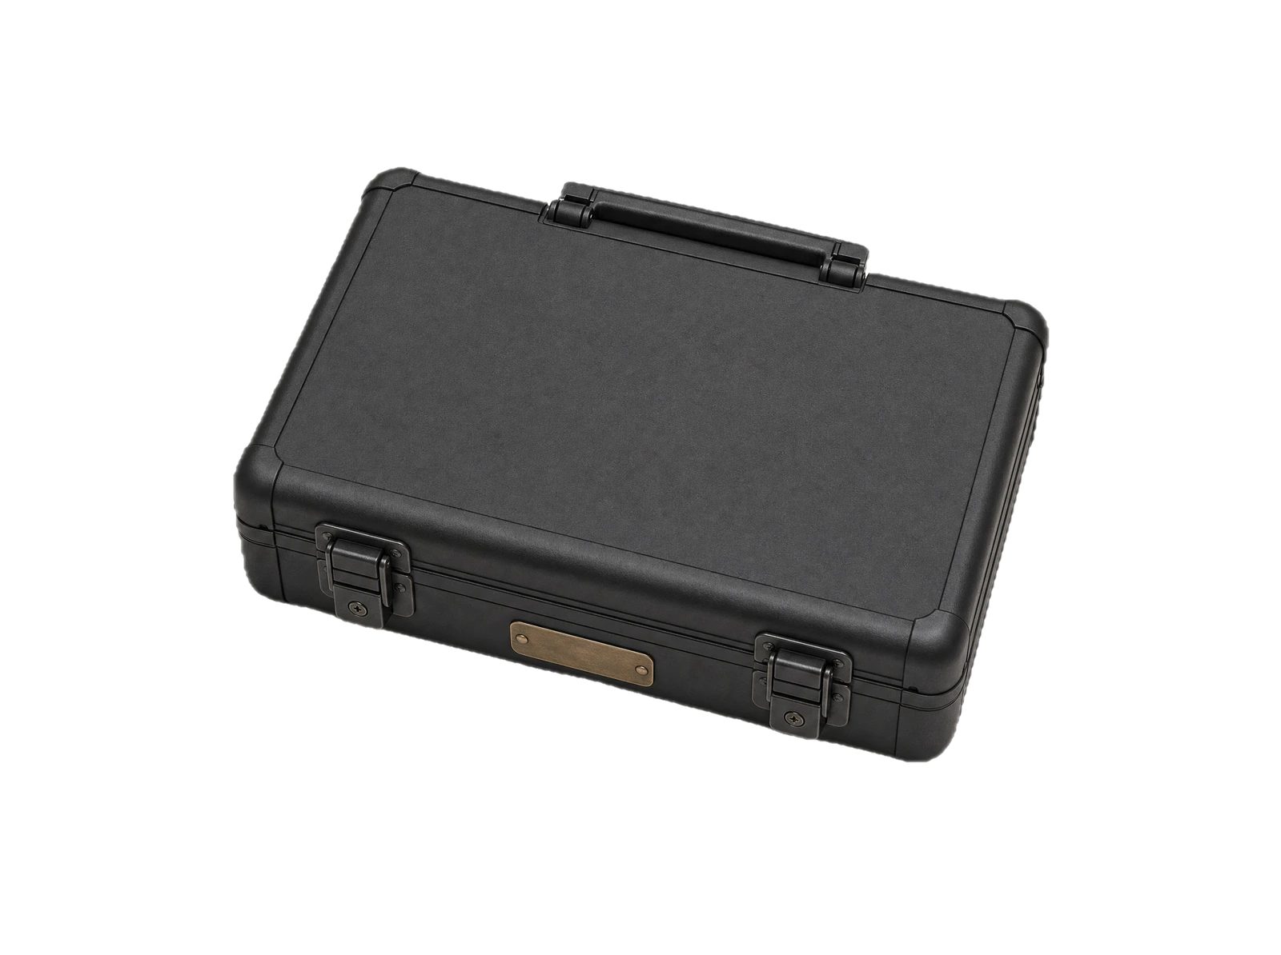
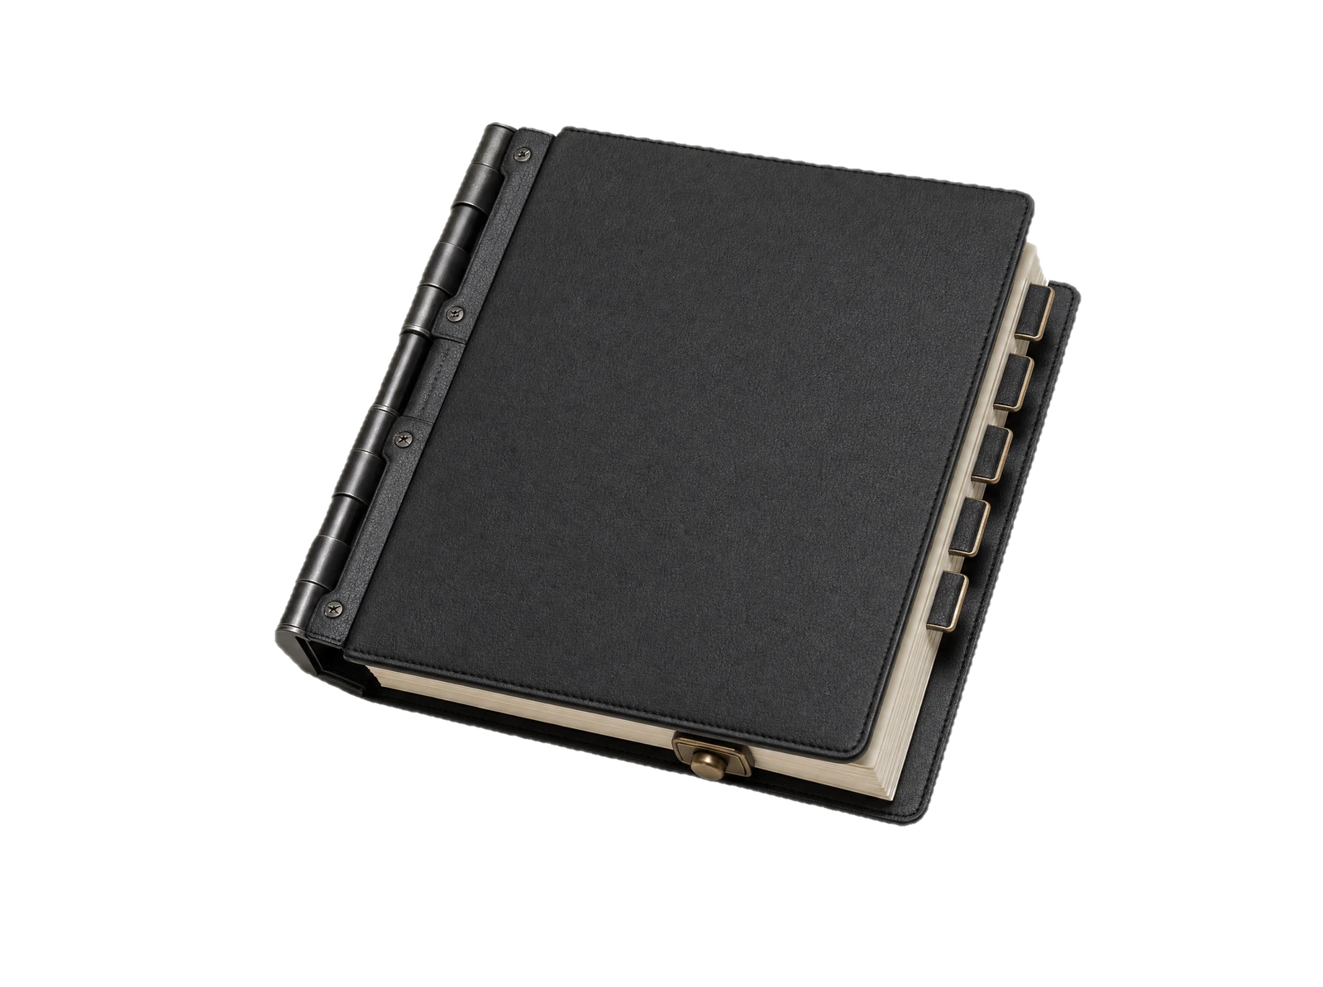
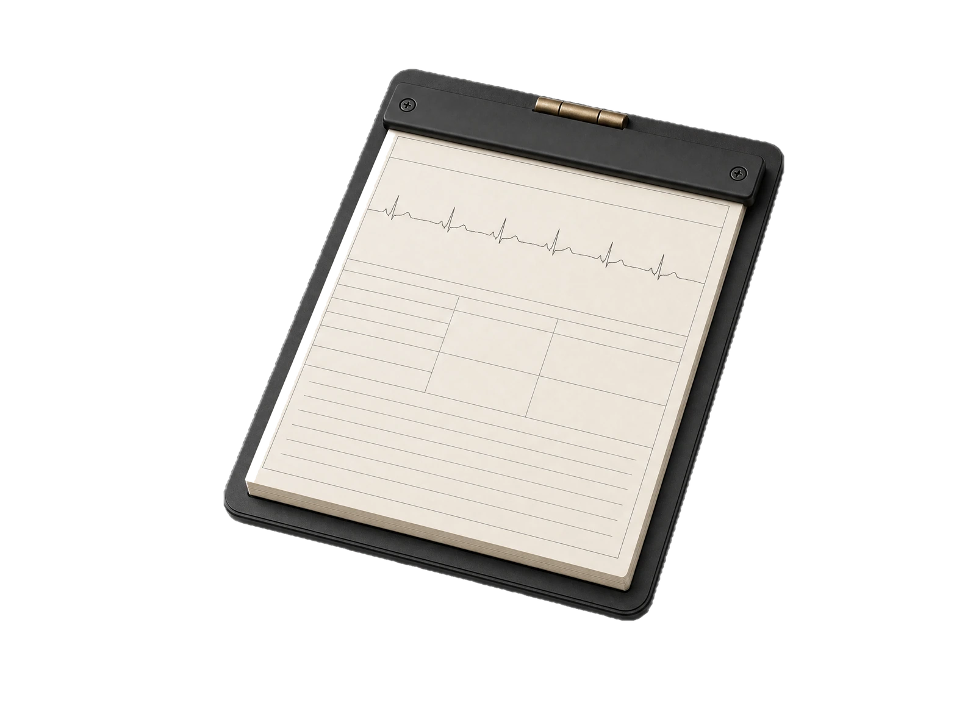
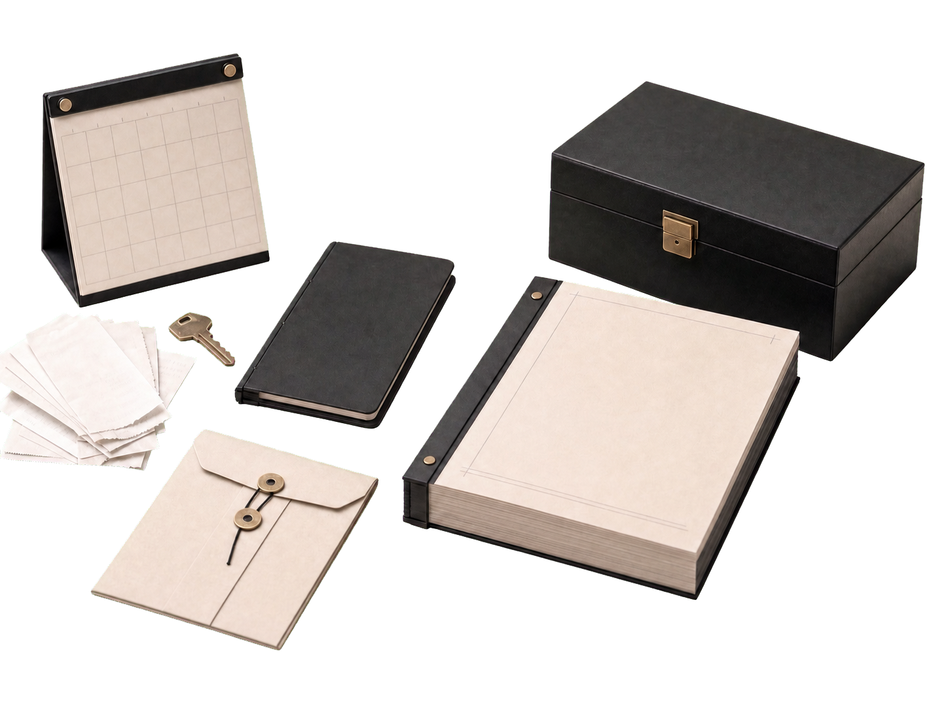
SPLAY / CORPORATE BRIEFING
PRIVATE AI / PRE-ORDER 06 / 11
EXAMPLE USES BY SECTOR
SPLAY configures the system for each organization’s tasks and access requirements.
FEDERAL CONTRACTORS
LAW
MEDICAL
BUSINESS OWNERS
Teaming contacts
Award and pricing research
Past-performance search
Solution and proposal drafts
Deposition summaries
Contract comparisons
Matter search
Draft notes
Appeals
Record summaries
Proposals
Records and bids
Small internal tools
STAFF REVIEW THE WORK AND REMAIN RESPONSIBLE FOR PROFESSIONAL DECISIONS
SPLAY LLC / STAFFORD, VIRGINIA
SPLAY.LLC
Notes:
The examples describe tasks for federal contractors, law firms, medical practices, and business owners. Professional judgment and review remain with the customer.
[Sources]
- https://splay.llc/federal
- https://splay.llc/law
- https://splay.llc/medical
- https://splay.llc/personal
- https://splay.llc/paper/node-federal-2160.png
- https://splay.llc/paper/node-law-2160.png
- https://splay.llc/paper/node-medical-2160.png
- https://splay.llc/paper/node-pilot-1280.png
- https://splay.llc/media/splay/editorial/splay-federal-hero-floating-v01.webp
- https://splay.llc/media/splay/editorial/splay-law-hero-floating-v02.webp
- https://splay.llc/media/splay/editorial/splay-medical-hero-floating-v01.webp
- https://splay.llc/media/splay/editorial/splay-personal-organized-work-editorial-4x3-v01.jpg
[/Sources]

Slide 7
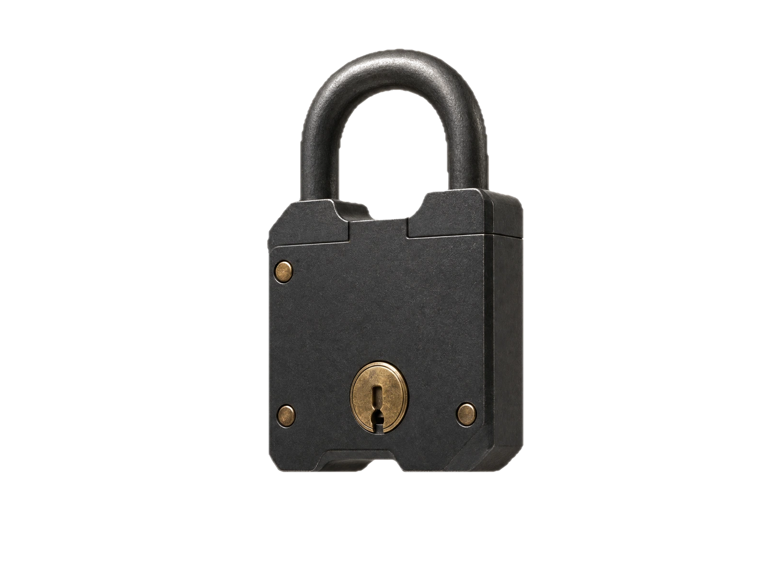
SPLAY / CORPORATE BRIEFING
PRIVATE AI / PRE-ORDER 07 / 11
LOCAL PROCESSING AND ACCESS CONTROLS
STANDARD
■
OUTBOUND MODEL TRAFFIC BLOCKED
CONFIGURATION
■
STAFF ACCOUNTS AND ACCESS RULES
The standard configuration processes files and AI requests locally. It can operate without public internet.
■
CUSTOMER-HELD BACKUPS AND RECOVERY
■
IT OPERATING DOCUMENTATION
LOCAL PROCESSING
■
NO UNATTENDED ACCESS TO CUSTOMER FILES
SPLAY KEEPS NO COPY OF CUSTOMER SNAPSHOTS
SPLAY LLC / STAFFORD, VIRGINIA
SPLAY.LLC
Notes:
In the standard installed configuration, files and model traffic stay on the customer’s machine and outbound model traffic is blocked. The system can operate without public internet. SPLAY does not keep customer files or snapshots. Support takes place on-site or in a customer-controlled, authorized session, with no unattended remote access. Organizations remain responsible for their policies and regulatory obligations.
[Sources]
- https://splay.llc#local
- https://splay.llc
- https://splay.llc/splay-overview.pdf
- https://splay.llc/media/splay/editorial/splay-local-by-design-lock-floating-v01.webp
[/Sources]

Slide 8
SPLAY / CORPORATE BRIEFING
PRIVATE AI / PRE-ORDER 08 / 11
OWNERSHIP AND OPERATING COSTS
SPLAY has no per-seat or per-answer charge. Capacity depends on the hardware.
FACTOR
SPLAY NODE
CLOUD SERVICES
PROCESSING
LOCAL IN STANDARD SETUP
REVIEW PROVIDER TERMS
ACCESS
STAFF ON YOUR NETWORK
PLAN-DEPENDENT LIMITS
PRICE MODEL
HARDWARE AND OPTIONAL CARE
PRICING VARIES BY SERVICE
CONTINUITY
OWNED HARDWARE
REVIEW SERVICE DEPENDENCIES
ADD A USER
$0 PER-SEAT FEE
MAY REQUIRE A LICENSE
WORKLOAD LIMITS APPLY
NO REQUIRED SUBSCRIPTION
OPTIONAL MANAGED CARE
SPLAY LLC / STAFFORD, VIRGINIA
SPLAY.LLC
Notes:
There is no per-seat charge and no per-answer charge. Adding a user has a $0 per-seat fee, but more hardware is required when the workload exceeds installed capacity. Managed Care is optional. Cloud service pricing, limits, and contract terms vary by provider and plan.
[Sources]
- https://splay.llc/splay-overview.pdf
- https://splay.llc#own
[/Sources]

Slide 9




SPLAY / CORPORATE BRIEFING
PRIVATE AI / PRE-ORDER 09 / 11
MACHINE OPTIONS AND INSTALLED PRICES
Pre-order only. Published prices include installation.
128GB
256GB
512GB
BUILT TO ORDER
NODE 01
NODE 02
NODE 03
NODE 04 / 09 / X
$14,500
$32,500
$59,500
04: FROM $129,500
1–15 STAFF
16–30 STAFF
CAPACITY VARIES BY MODEL
09: FROM $195,000
BASELINE: LAGUNA S 2.1
TWO LINKED MACHINES
FOUR LINKED MACHINES
NODE X: BY INQUIRY. SIZED AFTER CONSULTATION
90 DAYS OF LAUNCH CARE INCLUDED. OPTIONAL MANAGED CARE FROM $600/MO.
SPLAY LLC / STAFFORD, VIRGINIA
SPLAY.LLC
Notes:
All machines are available for pre-order. NODE 01 has 128GB and costs $14,500 installed for 1–15 staff. NODE 02 has 256GB across two linked machines and costs $32,500 installed for 16–30 staff. NODE 03 has 512GB across four linked machines and costs $59,500 installed. NODE 04 starts at $129,500. NODE 09 starts at $195,000. NODE X pricing is by inquiry. All machines include 90 days of Launch Care. Managed Care is optional afterward and starts at $600 per month. Published prices are subject to change.
[Sources]
- https://splay.llc#machines
- https://splay.llc/splay-overview.pdf
- https://splay.llc/paper/node-01-320.png
- https://splay.llc/paper/node-02-320.png
- https://splay.llc/paper/node-03-448.png
- https://splay.llc/paper/node-04-320.png
[/Sources]

Slide 10
SPLAY / CORPORATE BRIEFING
PRIVATE AI / PRE-ORDER 10 / 11
INSTALLATION AND ONGOING OPERATIONS
Your IT staff operate the system using the supplied documentation.
AREA
SPLAY SYSTEM
CUSTOMER TASKS
PROCESSING
LOCAL IN STANDARD SETUP
AUTHORIZE SOURCE FILES
TEAM ACCESS
STAFF ACCOUNTS
ASSIGN ACCESS RULES
PRICE MODEL
MACHINE AND OPTIONAL CARE
ASSESS WORKLOAD CAPACITY
DEPLOYMENT
INSTALLED AND DOCUMENTED
PROVIDE NETWORK ACCESS
CONTINUITY
CUSTOMER-HELD SNAPSHOTS
MAINTAIN CURRENT BACKUPS
90-DAY LAUNCH CARE
MANAGED CARE OPTIONAL
CUSTOMER-CONTROLLED SUPPORT
SPLAY LLC / STAFFORD, VIRGINIA
SPLAY.LLC
Notes:
SPLAY installs and documents the complete system. Customer IT staff operate it using the supplied documentation, control staff access, and maintain current restore snapshots. Support includes 90 days of Launch Care. Managed Care is optional and does not provide unattended remote access.
[Sources]
- https://splay.llc
- https://splay.llc/company
- https://splay.llc/capabilities
- https://splay.llc/splay-overview.pdf
[/Sources]

Slide 11
SPLAY / CORPORATE BRIEFING
PRIVATE AI / PRE-ORDER 11 / 11
30-DAY NODE EVALUATION
Evaluate a Node on your network with your staff and documents.
30-DAY PILOT
01
WORKLOAD SELECTION
A recurring task using your source files.
$2,000
02
INSTALLATION
SPLAY installs the Node on your network.
03
EVALUATION
Staff assess output quality and time spent.
FULL CREDIT ON FINALIZED PRE-ORDER
04
PRE-ORDER DECISION
Decide whether to pre-order after 30 days.
30 DAYS ON YOUR NETWORK
SPLAY REMOVES THE PILOT MACHINE
IF YOU DO NOT PROCEED.
SPLAY.LLC/PILOT CONTACT@SPLAY.LLC
PILOT DETAILS AT SPLAY.LLC/PILOT
SPLAY.LLC
Notes:
The pilot costs $2,000 for 30 days on the customer’s network. SPLAY credits the fee in full when the machine pre-order is finalized. Staff evaluate the system with their own work. If the customer does not proceed, SPLAY removes the pilot machine.
[Sources]
- https://splay.llc/pilot
- https://splay.llc/splay-overview.pdf
[/Sources]

